Slide 1

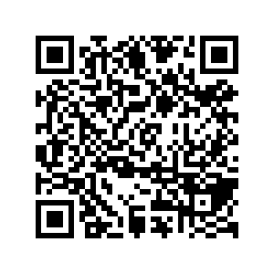
CS1010: Programming Methodology
UNIT 1
What is a Program?
Live Q&A
https://pollev.com/jin

Slide 2

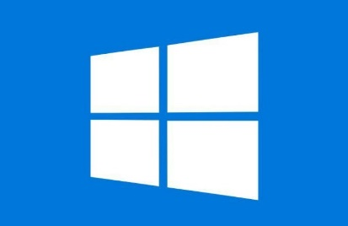


Hardware
Monitor and speaker (output)
Houses CPU, memory, hard disk, etc.
Software
Keyboard and mouse (input)

Slide 3
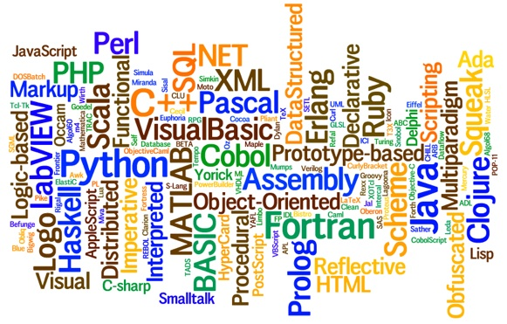
(Computer) Program
A sequence of step-by-step instructions given to computers to process data in order to perform a certain task.
Programming languages
Languages for writing programs
Notes:
~9000 Programming languages created in the history of programming. A few hundreds in active use.

Slide 4
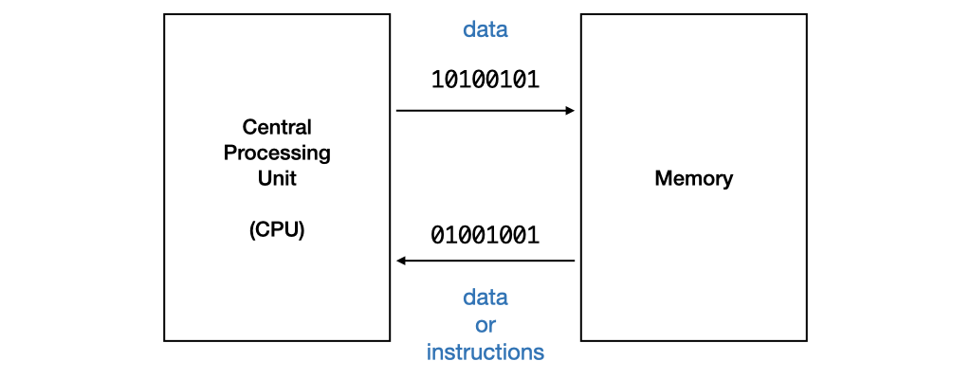
Combing Hardware and Software
Computer is designed to respond to programs written in machine code directly.
Each instruction is a binary code that corresponds to a native instruction.
E.g., 0001001101101110

Slide 5
Beyond Machine Code
Assembly code
High-level language program
Use mnemonic to represent the instructions, such as incr, store, jump, etc. in a more human-readable way.
Still difficult to write since the operations are really simple.
Requires translation
Detailed knowledge of the machine is not required. High level of abstraction, such as control structures, functions, object-oriented programming.
Ease of writing and understanding.
Eg: Java, C, C++, Python.

Slide 6
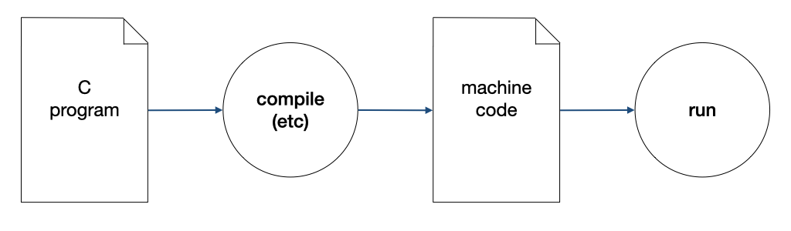
Compilation
A compiler compiles a program written in a high-level language to machine code.

Slide 7
The Edit, Compile and Execute Cycle
Compile
Execute
Edit
Use a compiler to translate the source code into executable
Use an editor to create/modify the source code
Execute/run the executable code
Process is iterative

Slide 8
What have You Learnt?
Fundamentals about Hardware and Software
Programming languages
The edit, compile, execute cycle
But how about problem solving by programming?

